Slide 1

Blockchain

Slide 2
Presented by : group 4
Zarin Sabah Teresa - 1964
Sabikun Nahar Monisha - 1967
Mayesha Sadia -1968
Barnita Barai Sithee -1979
Afrin Faria - 1981
Abu Ibrahim Md. Moeenuddin Miran - 2003
Md. Tawsif Rahman - 2005

Slide 3
General concepts of blockchain
Bank transactions could be failed sometimes for Technical issues, Account hacked, Transfer limits, High transfer charges etc.
To solve this problem here comes cryptocurrency (Digital or virtual currency) such as bitcoin, litecoin, ethereum & so on. There are many unethical transactions occurring around us. To control black money transfer there uses a database tool named blockchain.
Blockchain technology is a viable disruptor for markets including payments, cybersecurity, and healthcare because no data stored there can be changed. So, Block chain can be defined as the collection of records that are linked together in a strongly resistant manner to alter & protect using cryptography.

Slide 4
What is a Blockchain?
A blockchain is a decentralized, distributed ledger that records transactions on multiple computers in such a way that the record cannot be altered retroactively without the alteration of all subsequent blocks and the consensus of the network.
A blockchain is a digital ledger of transactions that is duplicated and distributed across the entire network of computer systems on the blockchain. Each block in the chain contains a number of transactions, and every time a new transaction is added, it is recorded in a new block that is linked to the previous block. This creates a chain of blocks that shows a permanent and unalterable record of all the transactions in the history of that blockchain.

Slide 5
Brief description of the concept of blockchain
It allows multiple parties to have access to the same information, while at the same time maintaining the privacy and security of the data through encryption and a consensus mechanism.
The data stored in a blockchain is organized into blocks, and each block is linked to the previous block through a cryptographic hash. This creates a chain of blocks that forms a tamper-evident record of all transactions in the network, ensuring that once data has been entered, it cannot be altered without the consensus of the network.
Blockchains are often used as the underlying technology for cryptocurrencies, but they have many other potential applications in areas such as supply chain management, voting systems, and more.

Slide 6
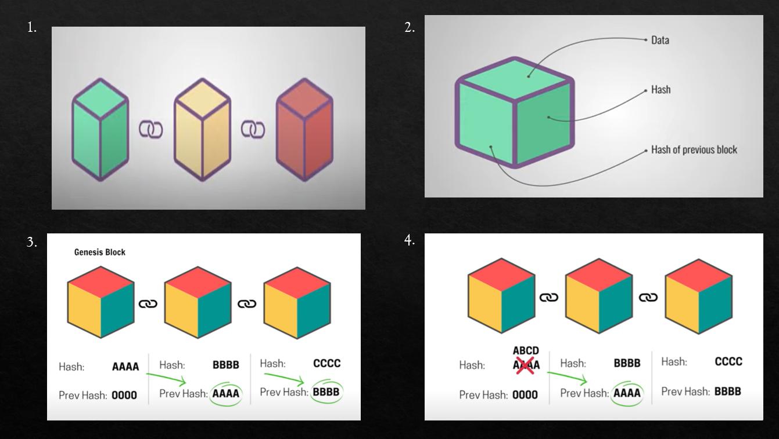
Process

Slide 7
Elements of blockchain
Each block contains 3 things:
o Data
o Hash
o Previous hash
In the chain the 1st block doesn’t store any previous hash, that block is called genesis block…

Slide 8
Database vs blockchain
o Only admin can access the central database where blockchain is a decentralized system where every information is shared with others over the network.
o Admin can easily modify any information in the database, but changes in blockchain is difficult. Hackers or middle man cannot easily change all the info stored together in blockchain.

Slide 9
Working of blockchain network
The step to step explanation to the working of Blockchain is explained below
Let’s start with the person who requests a transaction say it is A. Let A has to send some digital currency to B
The requested transaction is represented online as a block.
A verified transaction can involve crypto-currency, contacts, records, or other information.
This block is now broadcast to every party in the network.
Those in the party look for the validity of the transaction.
Once verified, the block is then added to the chain which provides an incredible and transparent record of transactions. And which is also permanent and unalterable.
The digital currency moves from A to B. Transaction is complete.

Slide 10
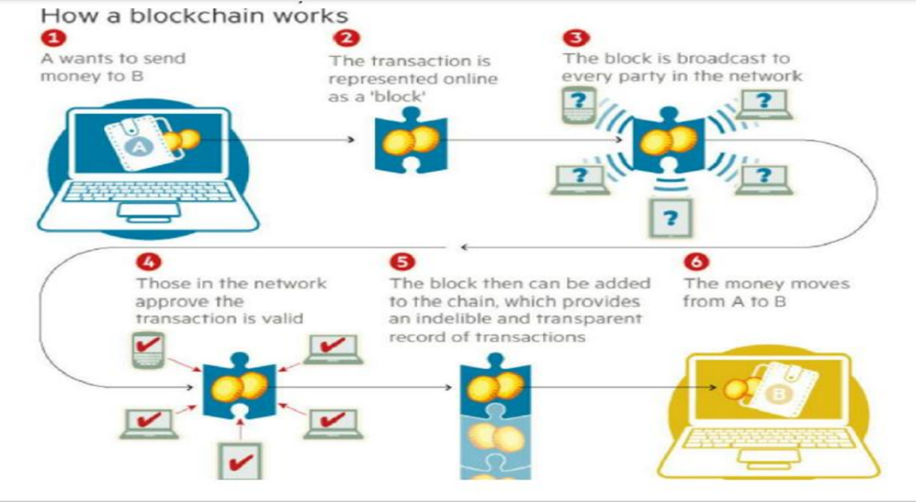
How blockchain works

Slide 11
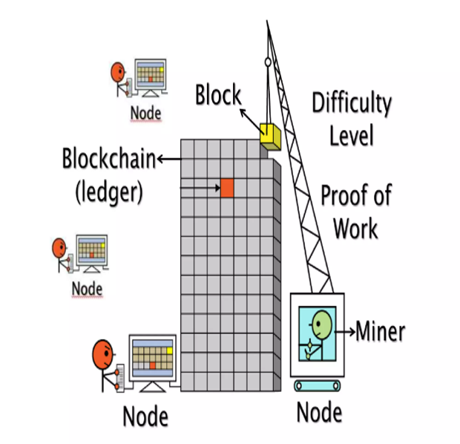
Elements & types :
Elements of Blockchain:
Nodes
Miner
Ledger
Proof of Work
Network Consensus
Blockchain has two terms:
Public blockchain
Private blockchain

Slide 12
Public and private blockchain
Public Blockchain: It is blockchain in which transaction can happen opaque and unnamed way which makes it more suspicious that who is doing this transaction how is it managed. A public blockchain, like bitcoin, ethereum and etc, does not have single administrator. There is no single point of failure based on the agreement of between the user. It is very easy to attack on the public blockchain
Private Blockchain: In private blockchain transactions are not known to each other, the data cannot be found in any public accessible area, but in this each member is known to each other. A participant cannot read or write the Blockchain in a private Blockchain network unless they have permission or an invitation to do so. It is more secure and reliable as compared with the public blockchain

Slide 13
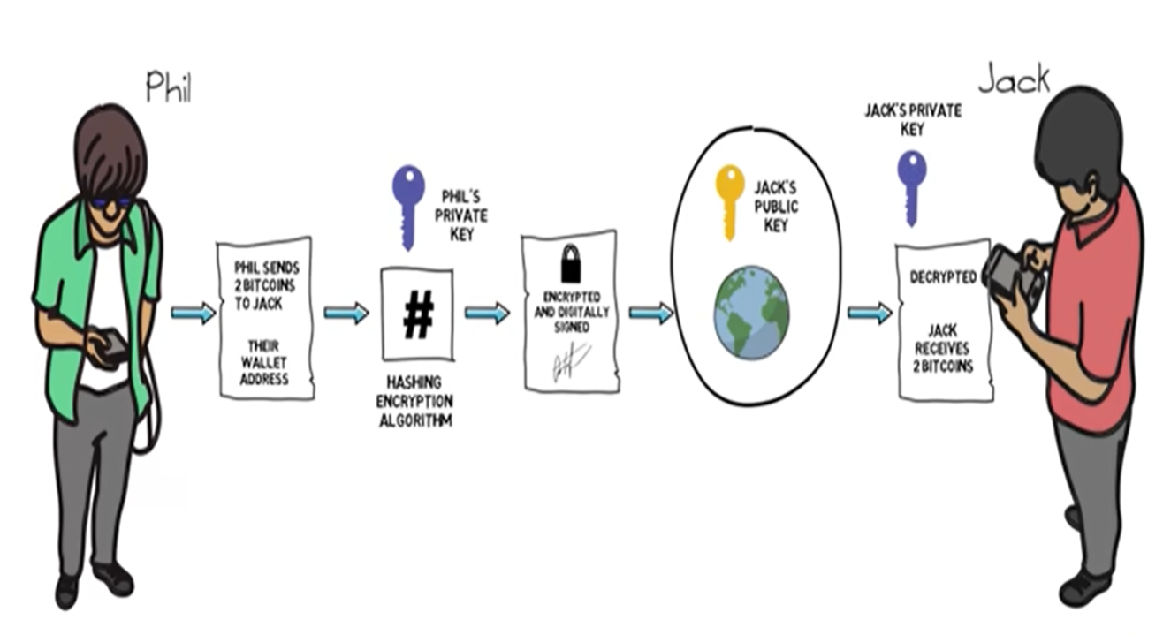
example of transactions

Slide 14

Applications of blockchain
Currency
E-Voting System
Smart Contacts

Slide 15
Application areas of blockchain
1.Currency: The major application of blockchain technology is currency, specifically Bitcoin, which was designed as an online international currency. Bitcoin has played a significant role in the development of blockchain technology and its use has been widely researched. However, the focus of discussion has shifted to how Bitcoin's dominance in the blockchain field could impact the development of the technology and other applications of distributed ledgers.
2.E-Voting: Blockchain technology has been proposed for use in e-voting as a way to increase engagement, transparency, and security. Blockchain-enabled e-voting would allow voters to manage and hold a copy of the voting record, increasing transparency and making it more difficult to alter votes. This shift towards e-voting using blockchain technology would move power and trust from central actors to citizens.

Slide 16
Application areas of blockchain
3.Network Operations: The IBM Blockchain Platform allows for easy setup of a blockchain network with a user-friendly interface. The platform allows the creator to initiate the network, invite participants, and configure core components such as identity verification and channel creation for secure transactions. The platform also provides monitoring tools such as a Network Traffic Dashboard and Network Health Monitor to ensure smooth network operations and activity tracking.
4.Smart contracts: Blockchain ledger has unique features compared to traditional ledger, including recording transaction details and time, playing an active role in managing transactions, and having the ability to automatically execute transactions based on certain conditions. This leads to the development of self-executing smart contracts, which are agreements programmed into code stored on the blockchain that automatically execute when certain conditions are met.

Slide 17
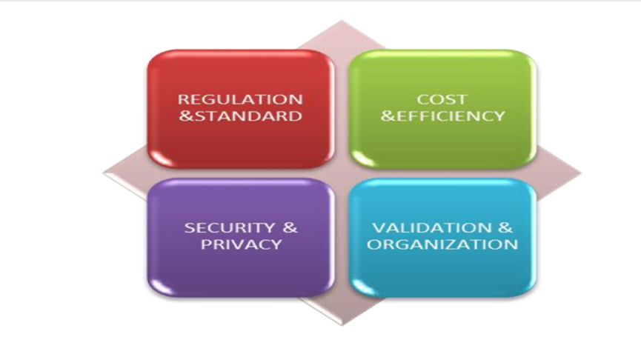
Challenges of blockchain

Slide 18
Challenges of blockchain
1.Regulations:The lack of regulation for blockchain transactions can negatively impact the important feature of transparency, particularly in highly regulated industries. There is a growing need for proper regulations to govern blockchain to address this issue and accommodate various situations.
2.Standards:There is currently a lack of a unified set of standards for writing blockchain transactions. This is due to the diversity of blockchain usage and the need to address these different use cases. The development of regulations to govern the blockchain environment will play a crucial role in driving the adoption of standards and may bring the various open source consortiums together.

Slide 19
Challenges of blockchain
3.Need more validation: A barrier to the adoption of blockchain technology is the fear of executives that it has not been sufficiently tested, particularly in terms of its scalability for handling a large volume of enterprise transactions and data. Different blockchain applications may face different scalability challenges as adoption grows, and there is a concern about the amount of time and computing power required to process a large number of transactions.
4.Culture:For a long time, transactions have been conducted in a certain traditional way, but the introduction of blockchain technology represents a significant departure from this approach. Instead of relying on a centralized network, blockchain relies on a decentralized one, which can be a difficult concept for some institutions to accept. The implementation of blockchain involves not only technological changes but also significant changes to business processes.

Slide 20
Challenges of blockchain
5.Cost and efficiency: There are several types of blockchain, each with varying speeds and levels of effectiveness for conducting transactions. While the most efficient and fast blockchain options can be costly, it is necessary to choose the best blockchain in order to provide the best service and maximize the benefits of blockchain technology.
6.Security and privacy : The transactions made using bitcoin are associated with "wallets" rather than individuals. However, for the effective use of blockchain technology, transactions and contracts need to be linked to identifiable individuals. This raises concerns about the privacy and security of the data stored and accessible on the blockchain. While the architecture of a blockchain has yet to be compromised, some institutions are hesitant to adopt this technology due to the perceived risks and challenges.

Slide 21
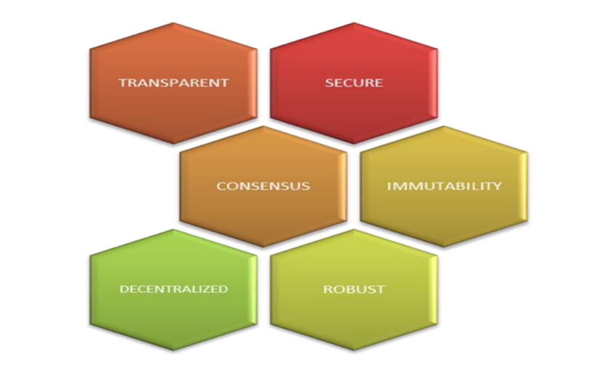
Special characteristics of blockchain

Slide 22
Special characteristics of blockchain
Security :
Based on consensus, cryptography and decentralization principles.
Each new block of information connects to all the previous blocks. So each block is nearly impossible to temper with.
Transparent and incorruptible :
Blockchain operates on the basis of consensus.
Changes made to blockchain transaction needs approvable of all nodes. With at least 100-200 nodes present in the network , it nearly impossible to corrupt data.

Slide 23
Special characteristics of blockchain
Consensus:
if any change is to be made on the blockchain transaction then before doing it we need to take the permission of all the individual nodes without them we cannot do the same.
Immutability of Data:
Once a transaction is agreed upon, it cannot be altered.
Subsequent transactions can be made, but the original transaction remains visible and cannot be hidden.
This leads to the concept of asset provenance, which allows us to trace the history of an asset, including its location and ownership, as well as the history of the asset's owner.

Slide 24
Special characteristics of blockchain
The idea of decentralization:
The blockchain is a decentralized technology.
Decentralization means that the control over all the processing is not with any single entity.
For example, A global network of computers uses the blockchain technology to jointly manage the database that records the Bitcoin transactions.
That is, Bitcoin is managed by its network as a whole, and not by any one central authority.

Slide 25

Thank You

